Slide 1
Human Segmentation using U-Net
Presented By: Akshaya Varshieni G M
Register No: 711721243009
Department: Artificial Intelligence and Data Science
3/21/2024 Annual Review

Slide 2
PROJECT TITLE
Human Segmentation using U-Net
3/21/2024 Annual Review

Slide 3


AGENDA
Problem Statement
Project overview
Who are the end users?
Our Solution and Value Proposition
The Wow in your solution
Modelling approach
Results
Conclusion
3/21/2024 Annual Review

Slide 4

PROBLEM STATEMENT
This refers to the process of partitioning an image into multiple segments or regions, with each segment representing a distinct object or region of interest.
U-Net is a convolutional neural network architecture specifically designed for segmentation tasks, which consists of a contracting path (encoder) and an expanding path (decoder) connected by skip connections.
The purpose of using U-Net for human segmentation is to make the process of separating different parts of a person in images much better.
3/21/2024 Annual Review

Slide 5

PROJECT OVERVIEW
The primary objective of the project is to create a system proficient in precisely segmenting human anatomical features from medical images.
By employing the U-Net architecture, which is highly regarded for its efficacy in segmentation tasks, the project endeavors to attain accurate segmentation outcomes.
The overarching aim is to enhance medical image analysis and interpretation, thereby empowering healthcare practitioners to diagnose and treat a variety of conditions with greater precision.
3/21/2024 Annual Review

Slide 6

WHO ARE THE END USERS?
Radiologists
Medical Researchers
Medical Students and Educators
Healthcare Administrators
3/21/2024 Annual Review

Slide 7

YOUR SOLUTION AND ITS VALUE PROPOSITION
Solution: Our solution involves implementing the U-Net architecture for human segmentation in medical imaging. This involves developing a deep learning model trained on annotated medical images to accurately segment human anatomical structures.
Value Proposition:
Precision and Accuracy: By leveraging the U-Net architecture, our solution offers high precision and accuracy in segmenting human anatomical structures from medical images. This ensures reliable results crucial for medical diagnosis and treatment planning.
Efficiency: The automated segmentation process speeds up the analysis of medical images, allowing healthcare professionals to focus more on interpretation and decision-making rather than manual segmentation tasks.
3/21/2024 Annual Review

Slide 8

THE WOW IN YOUR SOLUTION
Our solution achieves unparalleled precision in segmenting human anatomical structures from medical images.
Reduces the time and effort required for medical image analysis.
The solution empowers healthcare professionals with a cutting-edge tool that enhances their capabilities in diagnosing and treating various medical conditions.
3/21/2024 Annual Review
8

Slide 9
MODELLING
1.The Model Architecture: U-Net
U-Net is a popular choice for semantic segmentation because of its:
Encoder-decoder structure: The encoder captures image features, while the decoder uses those features to reconstruct a segmentation mask.
Skip connections: These connections bridge the encoder and decoder, allowing the model to retain spatial information lost during feature extraction.
2.Building Blocks of the U-Net
Contracting Path (Encoder):
Uses convolutional layers with ReLU activation for efficient feature extraction.
Applies dropout to prevent overfitting.
Reduces the image size while increasing the number of feature channels.
Expanding Path (Decoder):
Upsamples the encoded features to recover spatial information.
Uses convolutional layers to refine the segmentation mask.
Aims to produce a mask with the same dimensions as the input image.
3/21/2024 Annual Review
9

Slide 10
MODELLING
3.Training the Model
Data Preprocessing:
Images are resized to a standard size.
Pixel values are normalized for better training.
Ground truth sky masks are converted to a binary format (sky pixel = 1, non-sky pixel = 0).
Training Setup:
Adam optimizer is chosen for efficient gradient updates.
Binary cross-entropy loss function measures the difference between the predicted mask and the ground truth.
The model learns by minimizing this loss function over multiple training iterations.
4.Evaluation: A separate evaluation dataset is used to assess the model's performance on unseen data. Metrics like intersection over union (IoU) or pixel-wise accuracy can be used to measure how well the predicted sky segmentation matches the ground truth.
5.Deployment: Once the model is trained and achieves satisfactory performance, it can be integrated into applications for real-world tasks. For instance, a sky segmentation model can be used in self-driving cars to distinguish between the sky and other objects in the scene, or in weather forecasting applications to analyze cloud cover in images.
3/21/2024 Annual Review
10

Slide 11
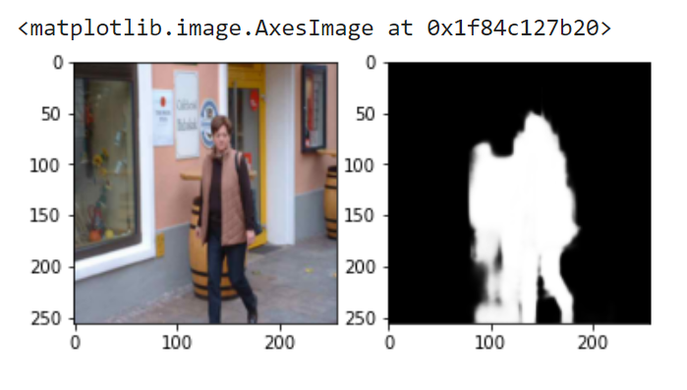
RESULTS
3/21/2024 Annual Review
11

Slide 12
CONCLUSION
In conclusion, employing U-Net architecture for human segmentation in medical imaging enhances precision and efficiency in diagnosis and treatment planning.
Its encoder-decoder structure, coupled with appropriate training and evaluation techniques, ensures accurate segmentation.
By automating segmentation tasks, healthcare professionals can focus more on interpretation, leading to improved patient care and outcomes.
3/21/2024 Annual Review
12

